Slide 1
Digital Books

Slide 2
Scope
The main scope of this project is to provide a digital library.
From here authors can fix some price to the book and can upload it to the website.
Now readers able to search the books and buy it from online.
This makes easy accessing to the readers instead of going to libraries.

Slide 3
User Types:
Authors
Readers
Guests

Slide 4
Author Actions:
Author able to register to the site with some of the mandatory details like Email Id and Mobile.
Up on successful registration he can able to login to the site.
Now after login he has ability to add the book with the complete content of the book.
Author can update the content of the book after he added.
Author can change the status of the book from active to inactive so that particular book will not be available for the readers to purchase.

Slide 5
Reader Actions:
Reader can perform registration to the site with some of the mandatory details like Email Id and Mobile.
Up on successful registration he able to login to the site.
After login he will landed up in the page where he can perform search books functionality based on the Author, Category of the book and Publisher of the book.
After getting results he can buy the book by entering his email id.
When the payment is succesful he can read the content of the book.

Slide 6
Guest:
Guest user has no registration and login.
Once he open the site, he will directly get navigated to search books page.
There user can perform search based on Author, Publisher and Category of the books.
Once he gets the result, he can perform payment by entering his Email Id.
After successful payment he can read the content of the book.

Slide 7
Technical Requirements:
Angular – Type Script
Asp.Net Core Web Api’s – C#
SQL Server

Slide 8
Software Requirements:
Visual Studio
Visual Studio Code
SQL Management Studio
Windows 10
Azure (For Deployment)

Slide 9
Functional Requirements:
Ocelot Gateway
Rabbit Mq
Azure Api Management
Azure App Services
Azure Sql Database

Slide 10
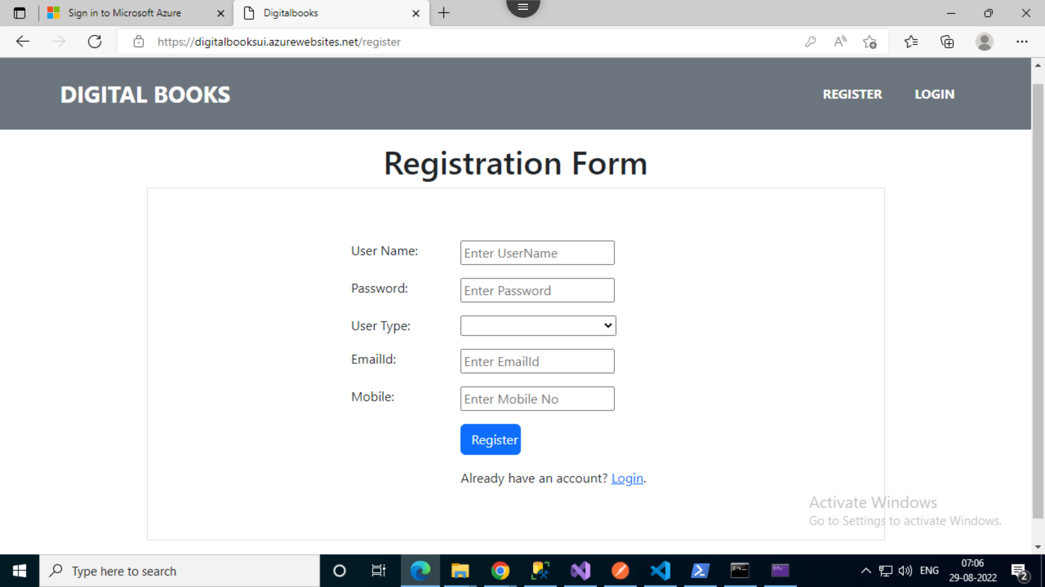
Screens:
Registration Page:

Slide 11
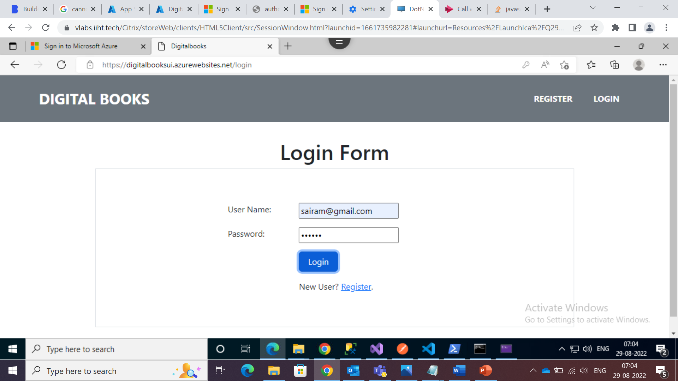
Screens:
Login Page:

Slide 12
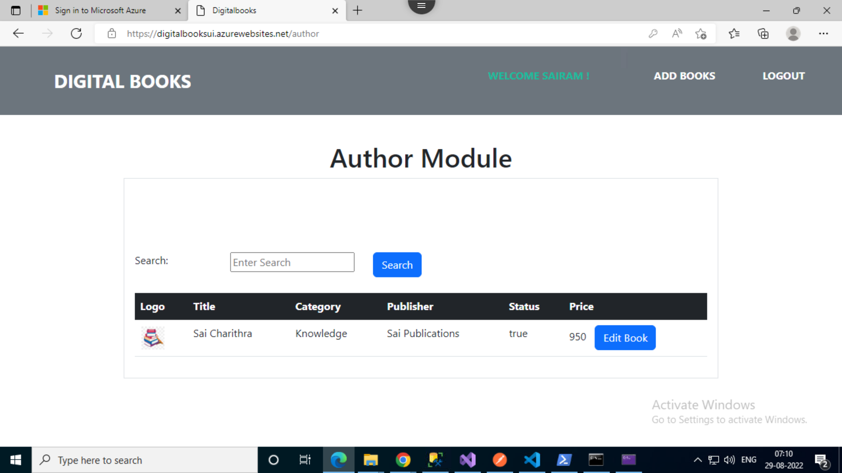
Screens:
Author Screen:

Slide 13
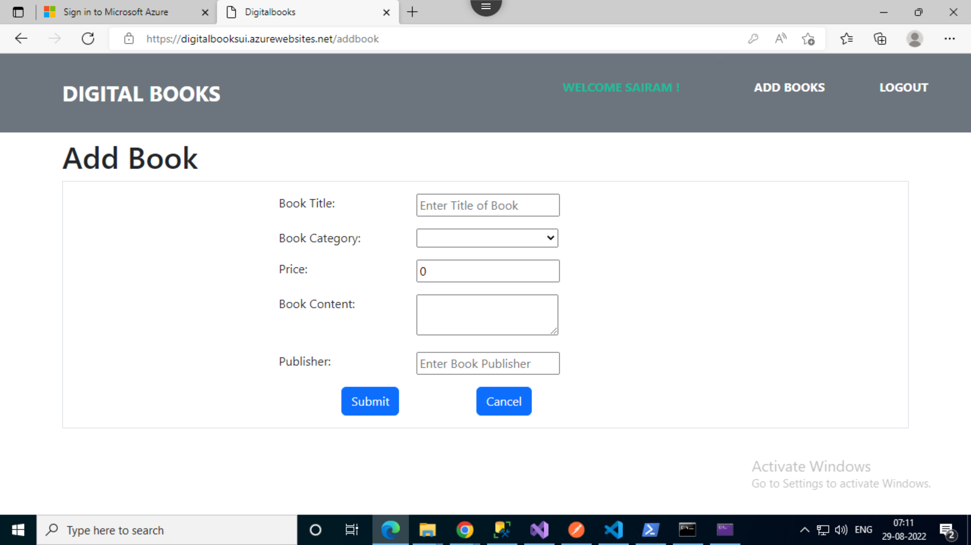
Screens:
Author Create Book Screen:

Slide 14
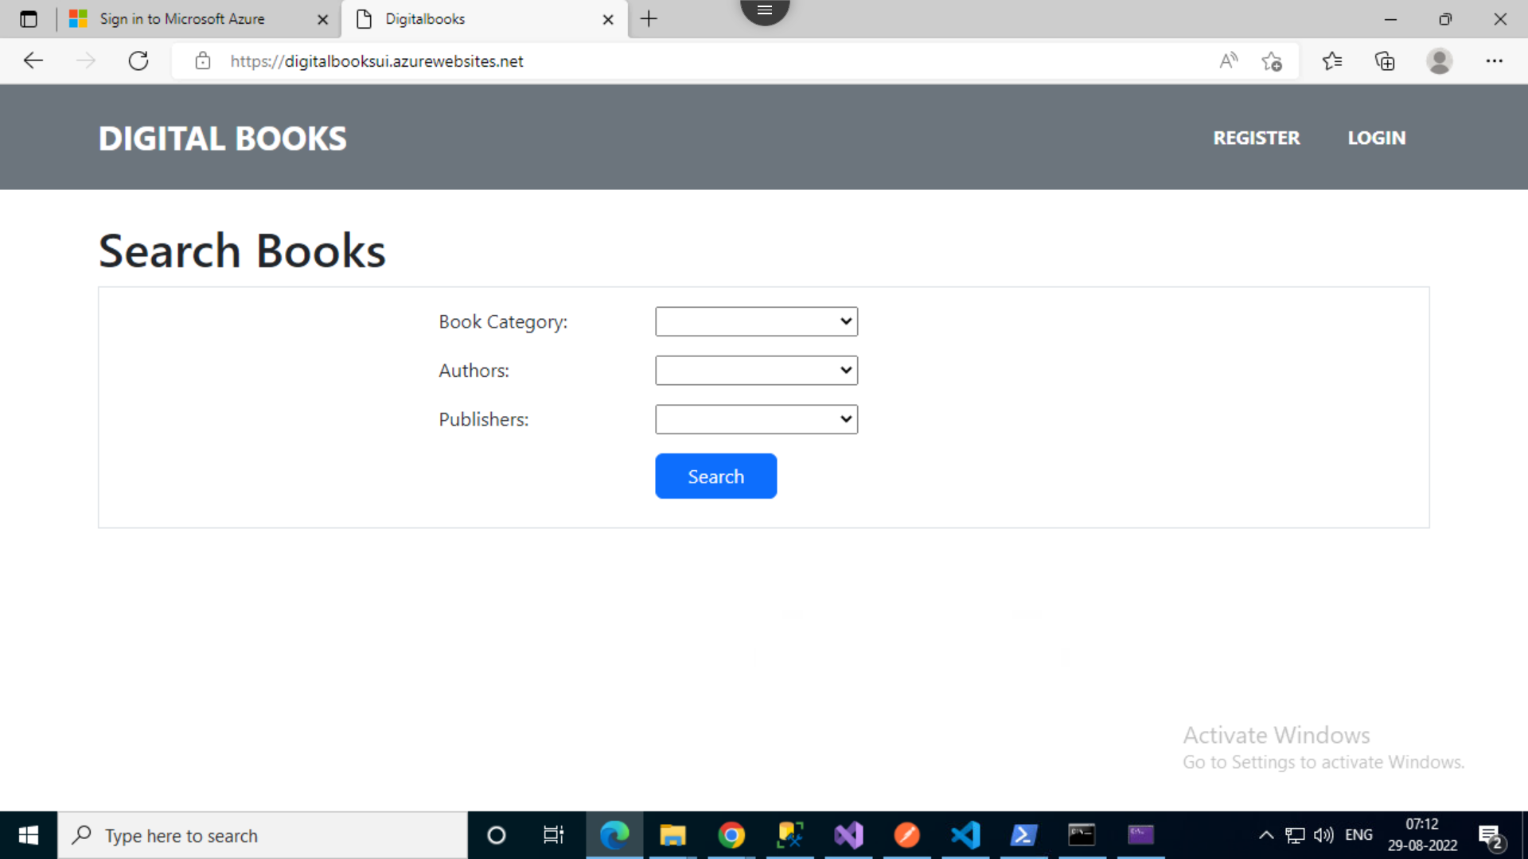
Screens:
Reader Screen:

Slide 15
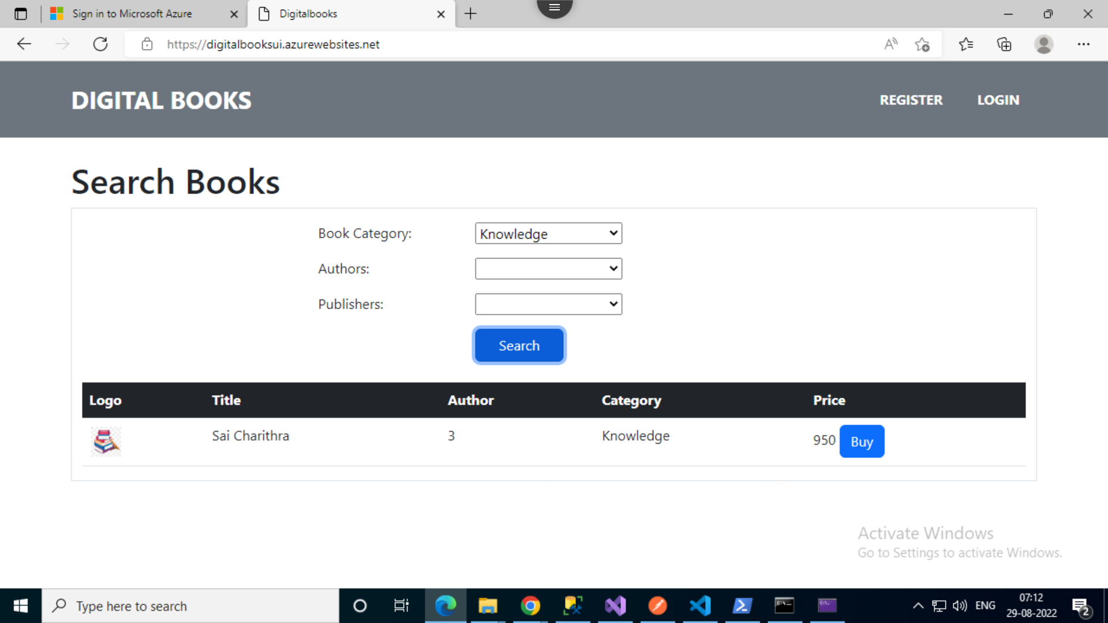
Screens:
Reader Search Display screen:

Slide 16
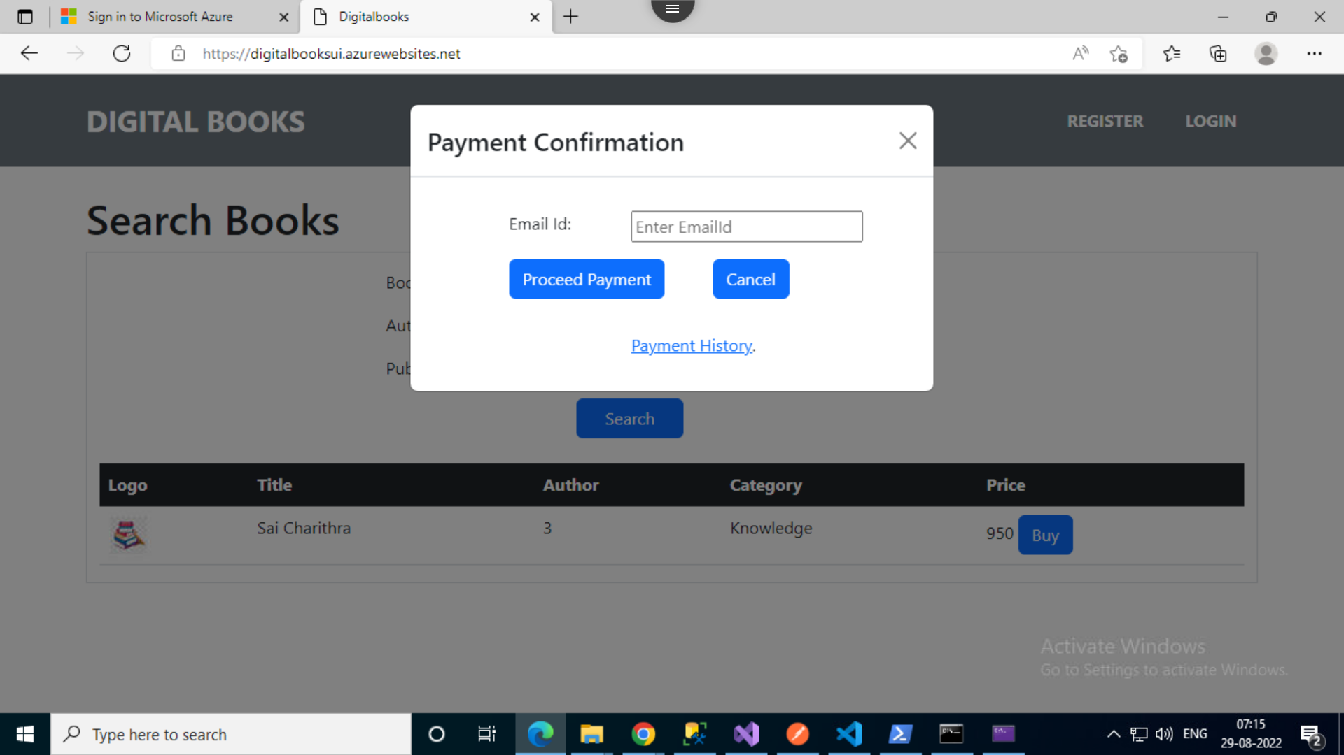
Screens:
Reader Payment Confirmation Screen:

Slide 17
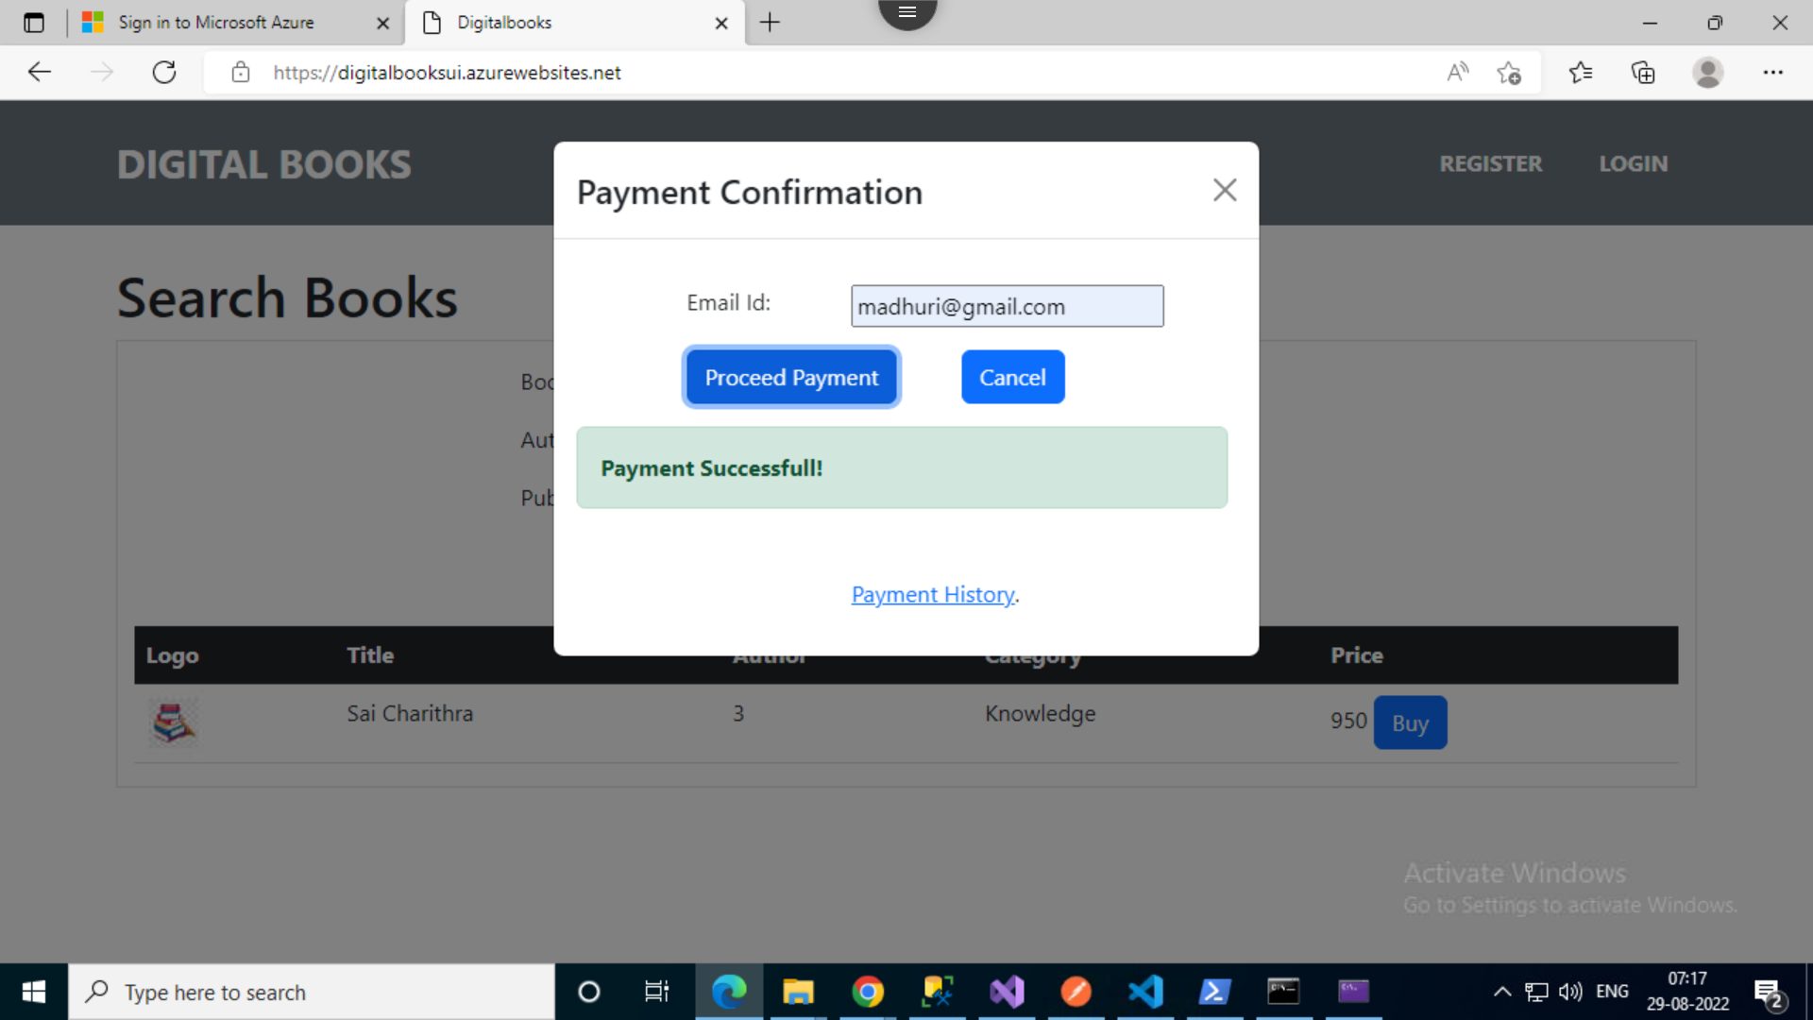
Screens:
Reader Payment Success:

Slide 18
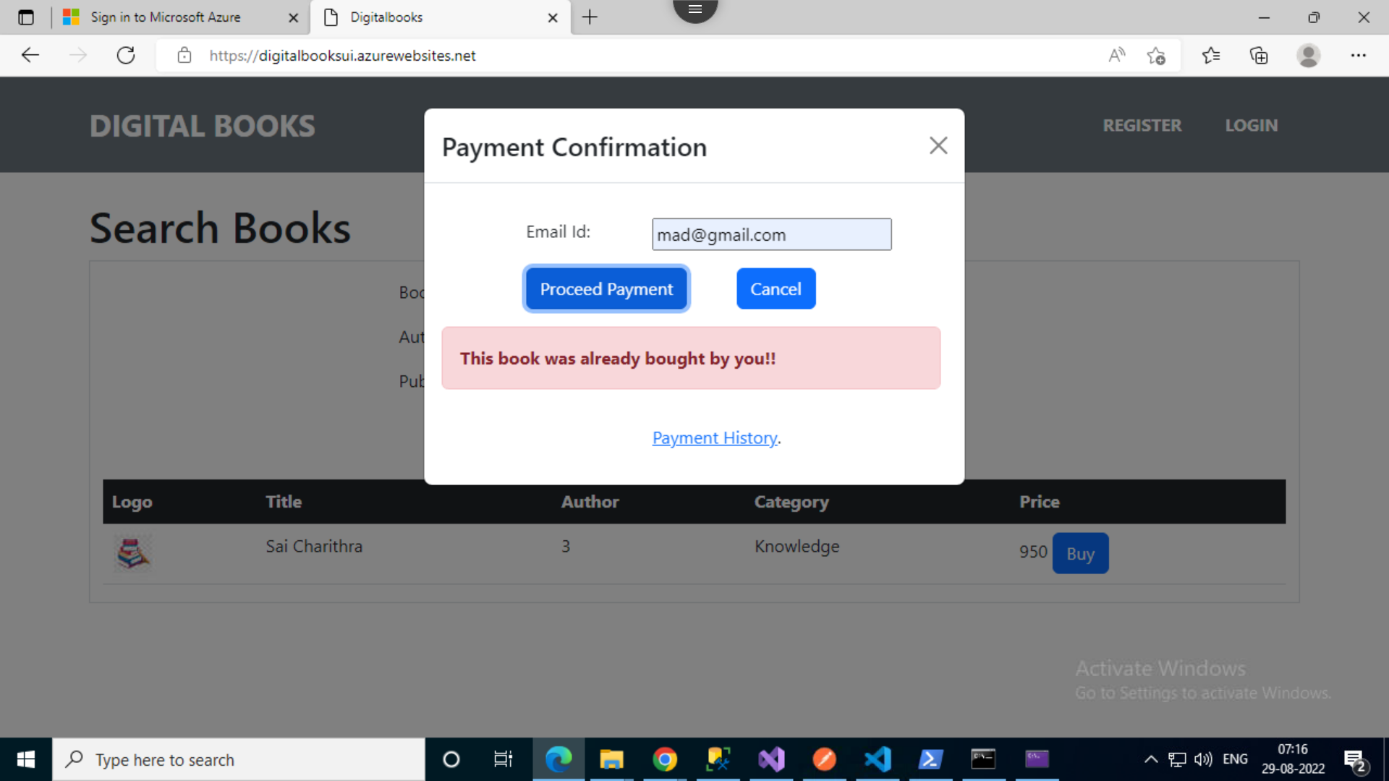
Screens
If a Book already purchased by Reader / Guest:

Slide 19
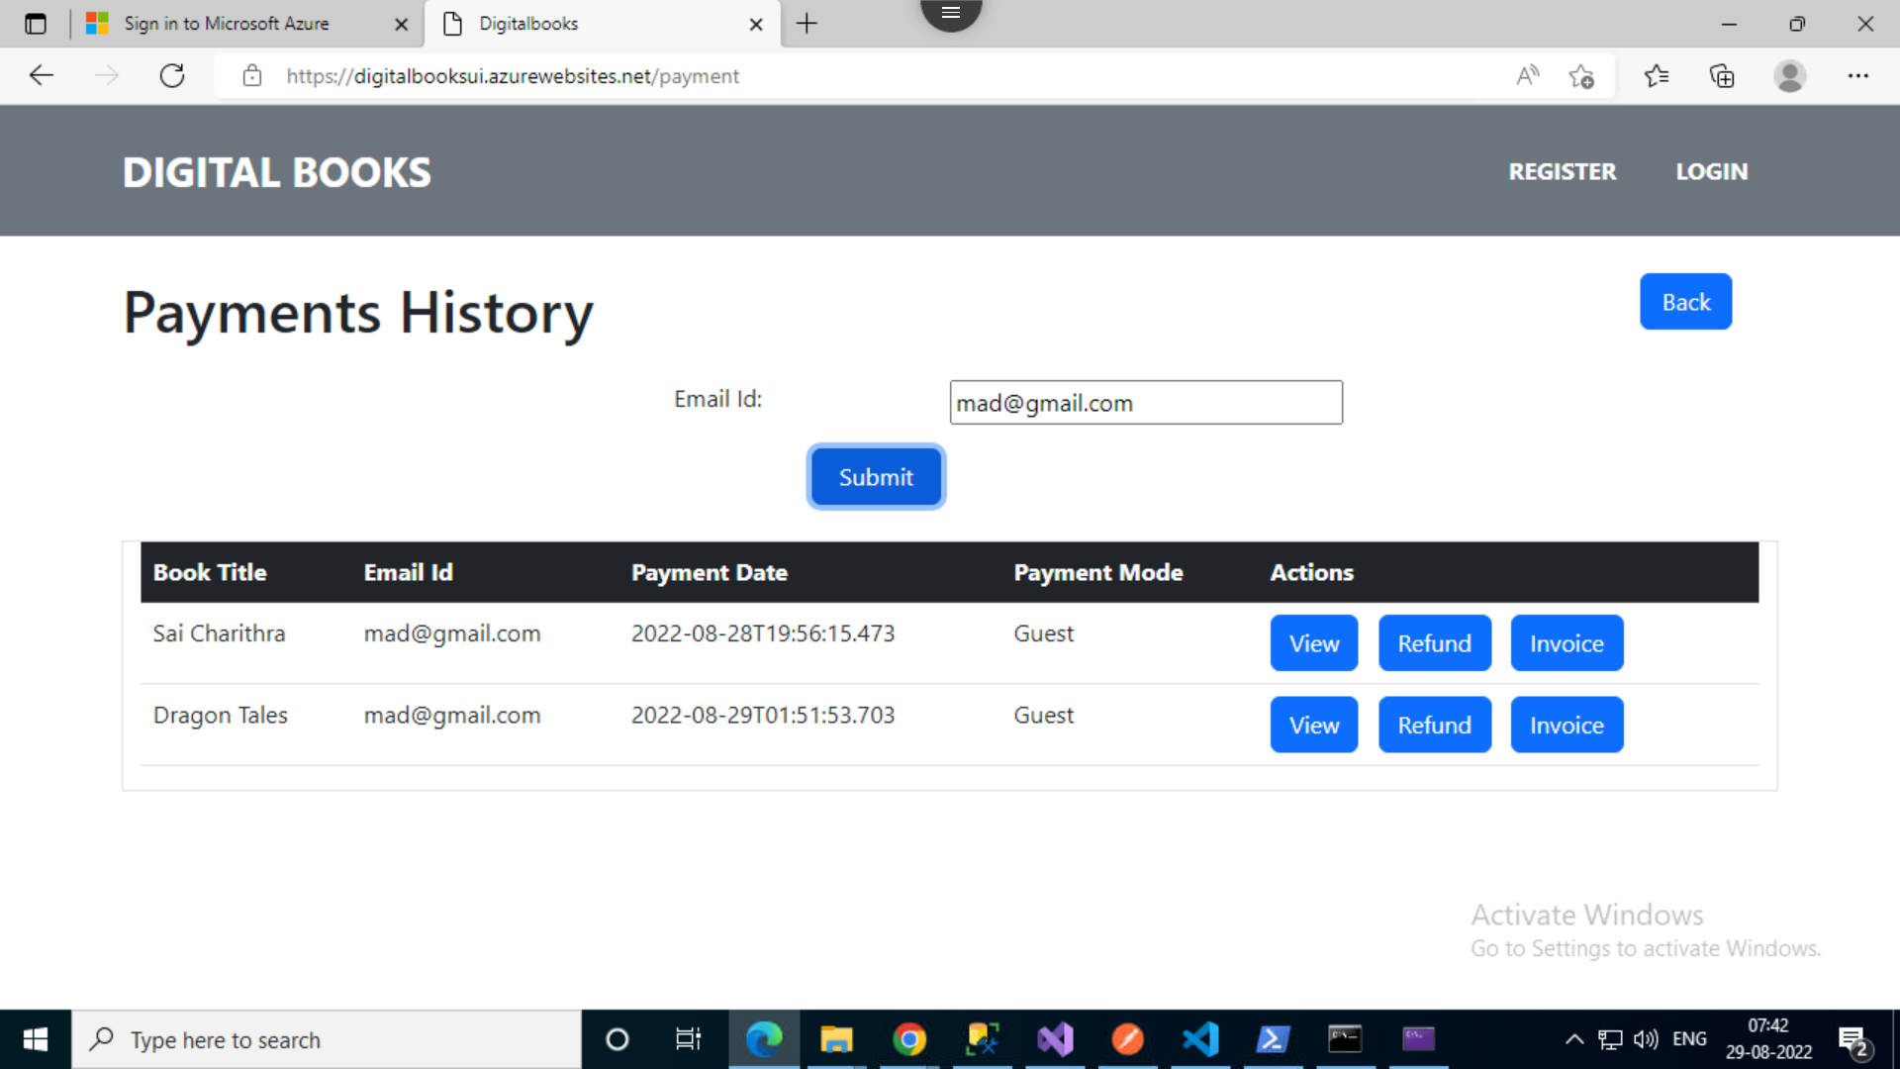
Screens
Payments History:

Slide 20
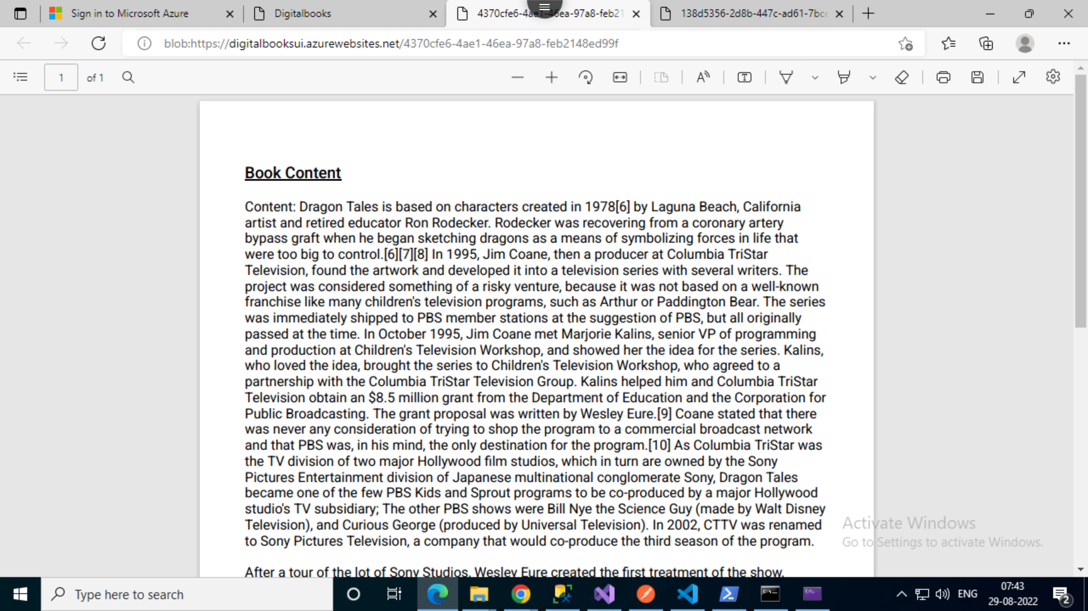
Screens
View Book Content:

Slide 21
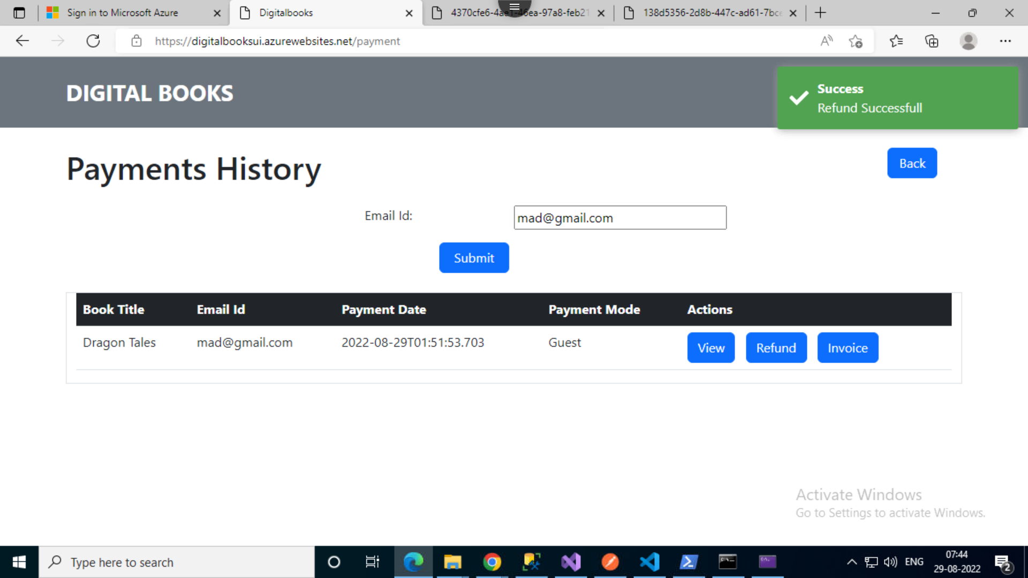
Screens
Refund Book:

Slide 22
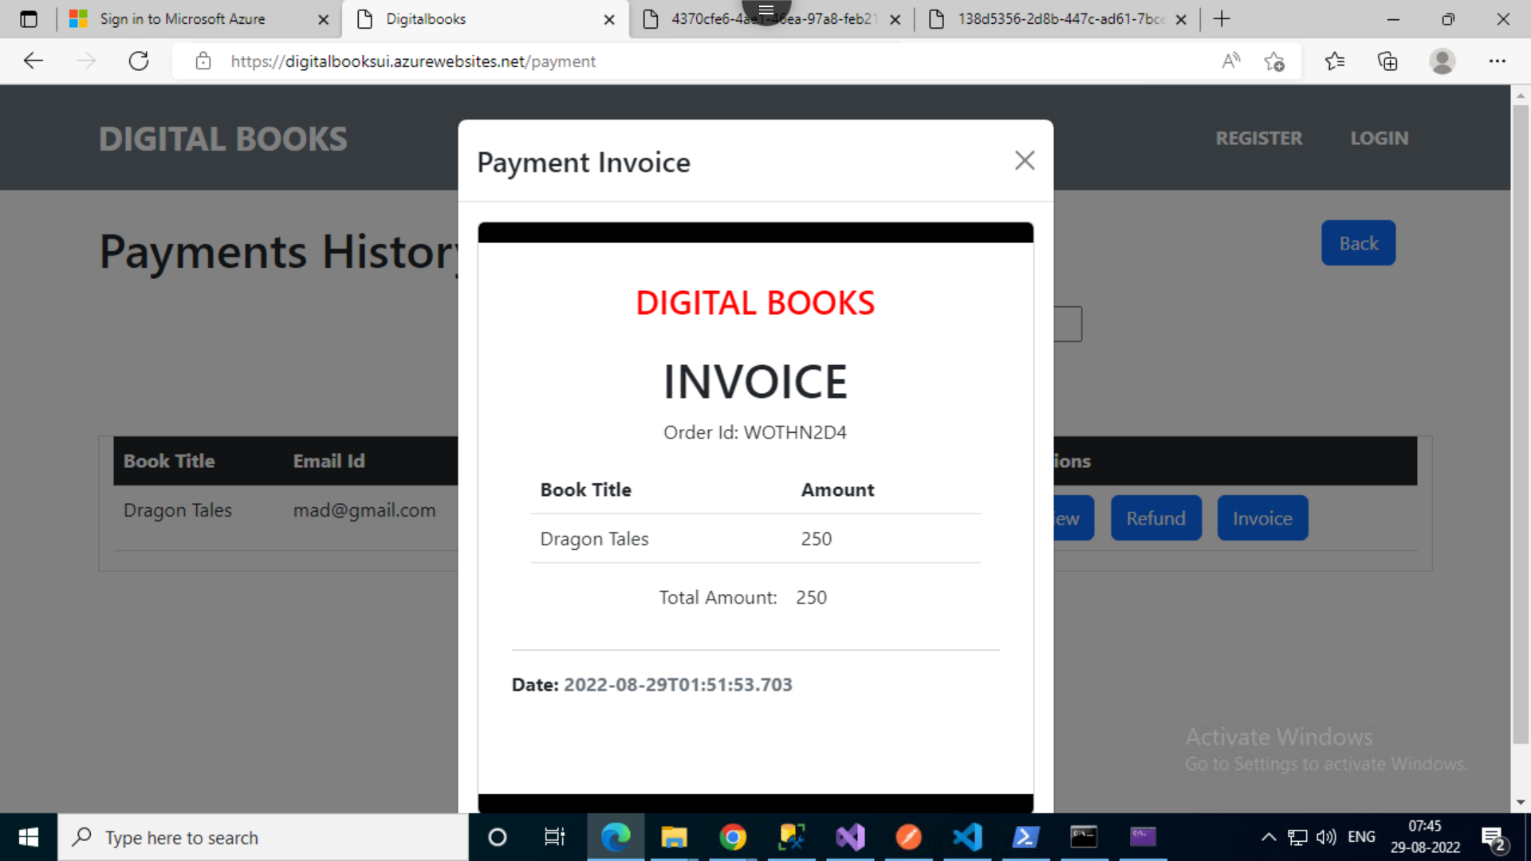
Screens
Invoice:

Slide 23

Thank You

Slide 24

Any Queries

